Slide 1
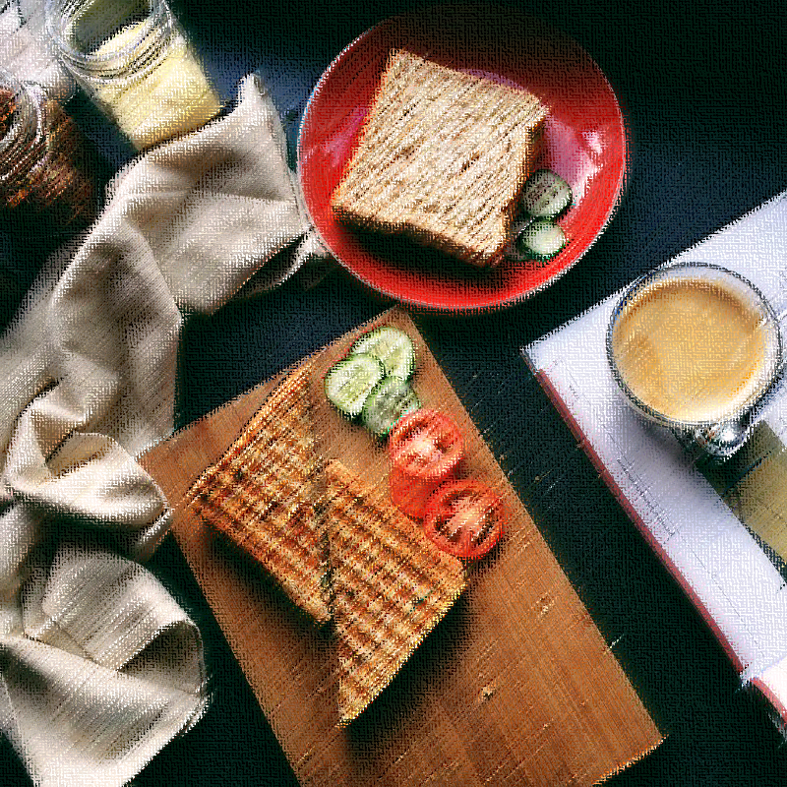

Enjoy Food, Enjoy Life
Never wasting too much time on any issue
but for enjoying food

Slide 2
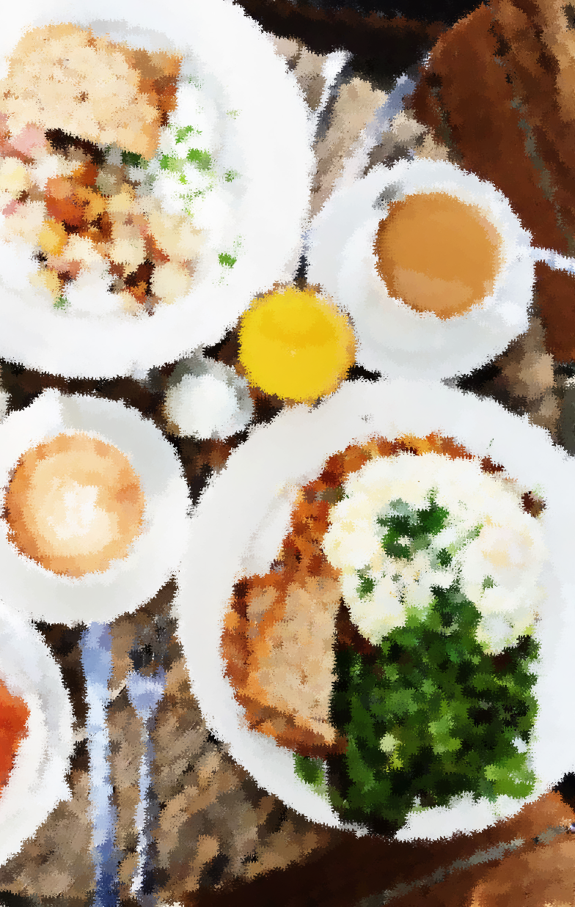
Presentation Outline
  Introduce our Task
  Design process
  1. Interview
  2. Affinity diagram
  3. Persona
  4. User Analysis and Scenarios
  Conceptual Design and Product function
  Storyboard and Storytelling
  Implementation Prototype
  User Testing
  Video

Slide 3
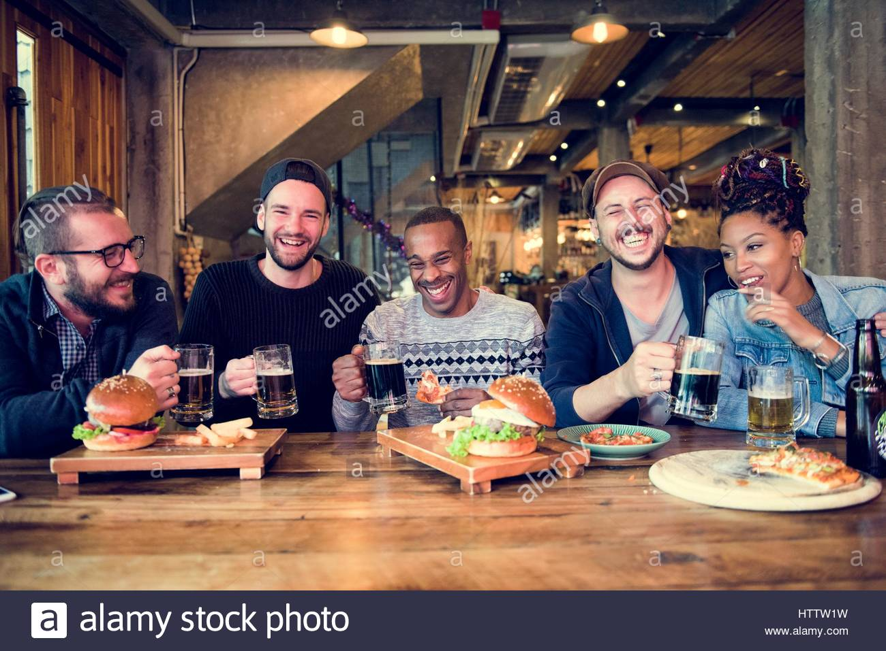

Introduce our Task
We may meet some problems about eating:
  I don’t know what to eat.
  There are too many people during eating time
  Some food is really not good to eat.
  …

Slide 4

Design process - Interview
Contextual inquiry: Please imagine that you are going to eat now.
Place: Lab, dorm room
People: 7 (4 Taiwaneses, 3 Foreigners)
  1 NTHU EE graduated student, Taiwanese
  1 NTHU EE undergraduated student, Taiwanese
  1 Sweden graduated student, Taiwanese
  1 Computer Engineer, Taiwanese
  1 NCTU EECS undergraduated student, India
  1 NCTU Chem PHD student, Polish
  1 NCTU Postdoc researcher, Polish
Time: 20 minutes for each person

Slide 5
Design process - Interview
Example Questions
How often do you eat outside? I eat outside every single day.
How long does it take to eat at outside ? 30 min
Will you want to wait for food ? Yes, 5 min is maximum
How do you pay ? Easy card -> cash -> credit card
How long does it take to commute for eating ? 15 min
How do you decide what to eat? Service, Price, good to eat or not
Do you have experience of being late because of eating ? Yes, waiting for meal.
Can the empty table, so you don’t have to wait, be an important factor in choosing the place to eat? Yes. Actually it is, quite often.

Slide 6
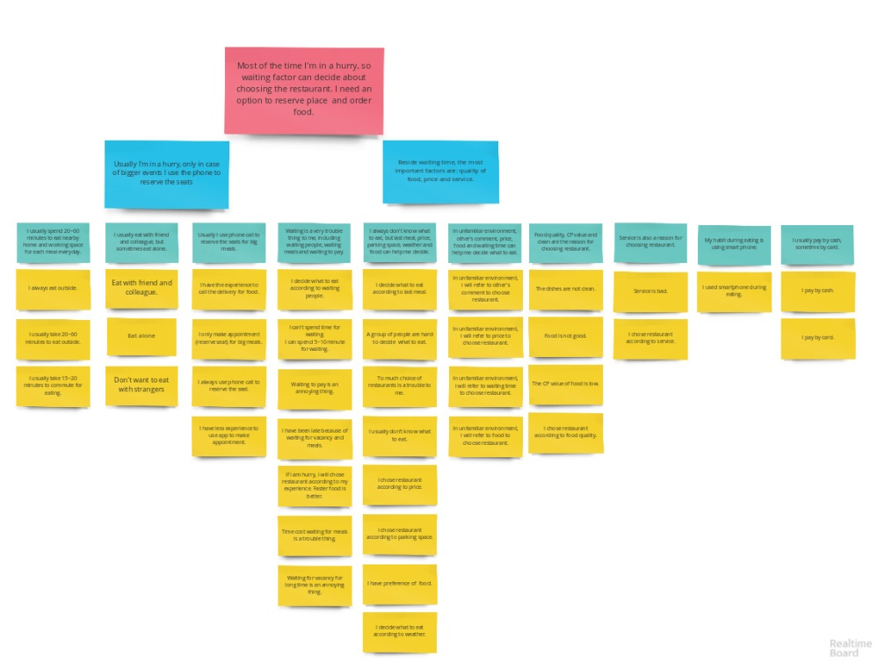
Design process - Affinity diagram
Most of the time, I'm in a hurry, so waiting factor can decide about choosing the restaurant. I need an option to reserve place and order food.
Beside waiting time, the most important factors are: quality of food, price and service.

Slide 7
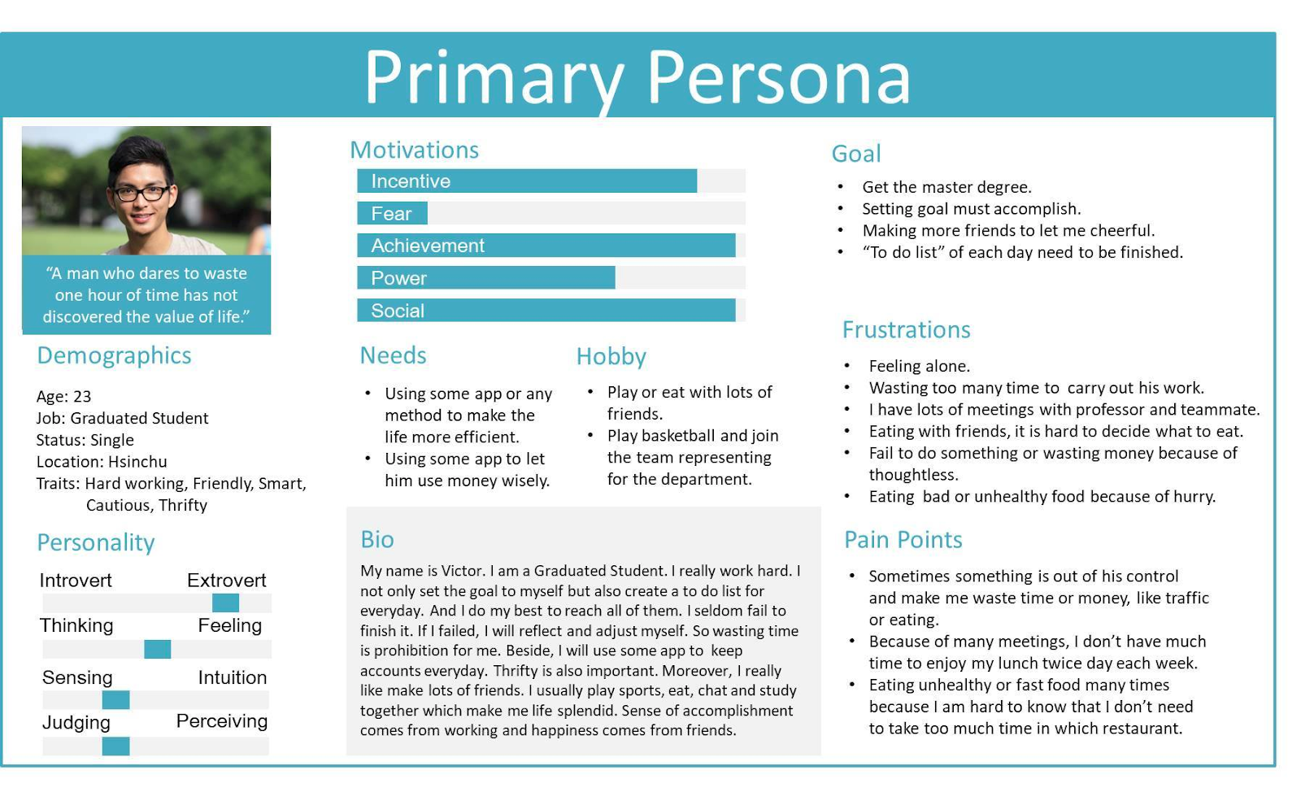
Design process - Taiwanese Persona

Slide 8
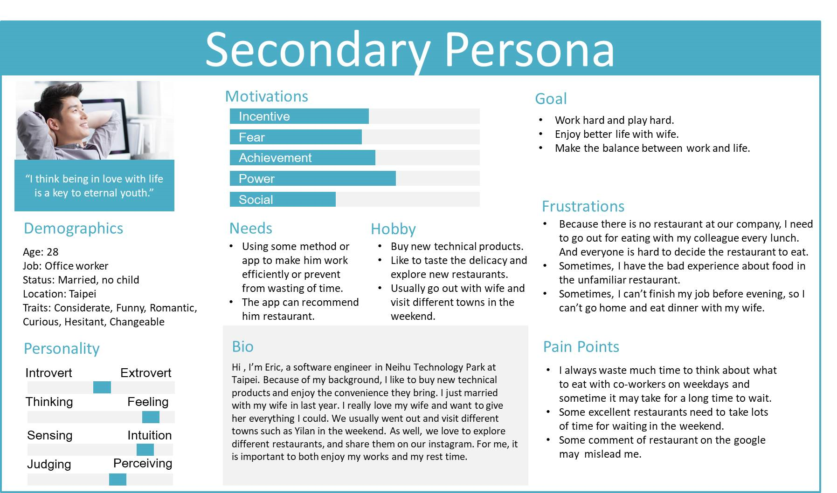
Design process - Taiwanese Persona

Slide 9
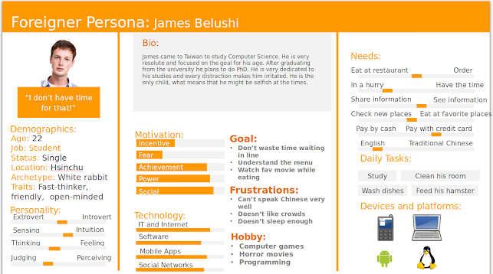
Design process - Foreigner Persona

Slide 10


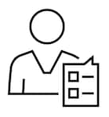

Design process - User Analysis
Definition of user group
  The people is troubled with waiting and finding for eating.
  The people is troubled with quality of restaurant.
  The people is familiar with high technology
User characteristics
  Impatient, Pay attention to efficiency
  Curious, Early adopter
  Enjoyment
User
  Sometimes: Normal people, like office worker and student
  Always: The people with “User characteristics”

Slide 11
Design process - User Analysis
Definition of user group
  The people is troubled with waiting and finding for eating.
  The people is troubled with quality of restaurant.
  The people is familiar with high technology
Problem of user group
  Late, Wasting too much time
  Eat bad food or meet bad service
Main reason
  Vacancy, traffic, waiting for food
  The comment on the Internet may not really precise

Slide 12
Design process - User Scenarios
User
  Sometimes: Normal people, like office worker and student
  Always: The people with “User characteristics”
Main reason
  Vacancy, traffic, waiting for food
  The comment on the Internet may not really precise
Scenarios
  Someone don’t want to take too much time to eat. (Student)
  Someone can’t late after breakfast, lunch or dinner (Office worker)
  Someone in unfamiliar place finds for eating. (Business trip or Travel)

Slide 13
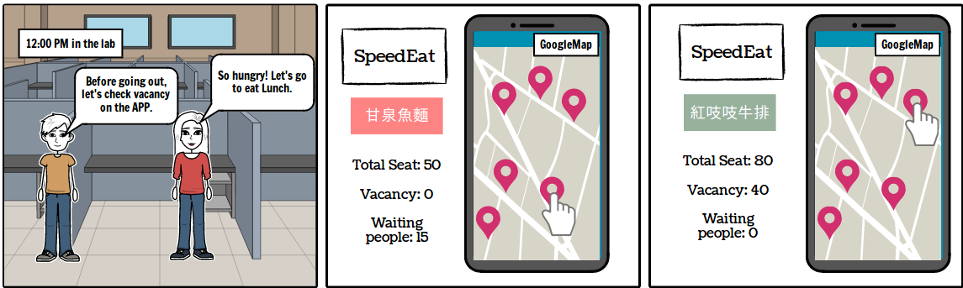
Conceptual Design and Product function
Someone don’t want to take too much time to eat.
Pain point: wait for vacancy, find restaurant, wait for meal
  1. A map with restaurant location
  2. Connect with Google Maps
  3. Show the vacancy of restaurant
  4. Booking service
  5. Ordering Service
  6. Showing the order of reserving

Slide 14
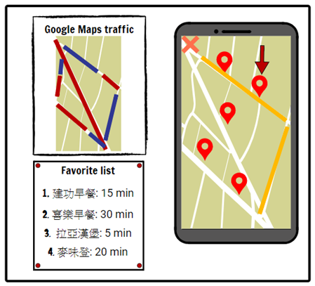
Conceptual Design and Product function
Someone can’t late after breakfast, lunch or dinner
Pain point: wait for vacancy, find restaurant, wait for meal
  1. Same function as previous
  2. favorite restaurant list
  3. Predict the time you need to
  take in certain restaurant
  4. the time needed to get there
  by walking or driving...
  5. Combine with 2,3,4 to plan a best path
  and restaurant for you

Slide 15
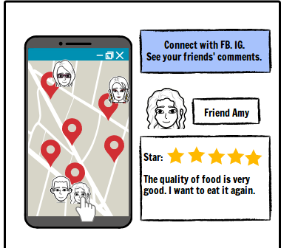
Conceptual Design and Product function
Someone in unfamiliar place finds for eating.(Business trip or Travel)
Pain point: wait for vacancy and meal, find restaurant, quality of restaurant
  1. Same function as previous
  2. Show your friends’ comment, score,
  check in and tag
  3. Make photos directly from our application
  and share it on Facebook, IG
  4. Connect with Google

Slide 16
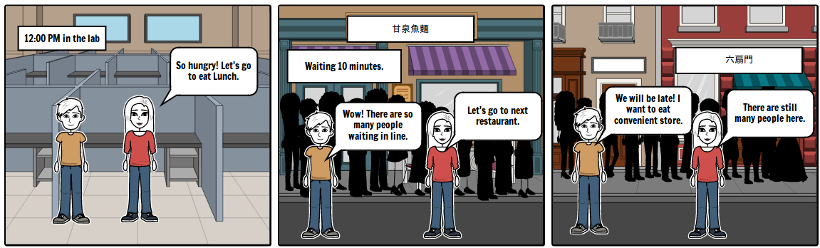
Storyboard and Storytelling - Scenarios 1
Before using our system…

Slide 17
Storyboard and Storytelling - Scenarios 1
After using our system…
Situation
System

Slide 18
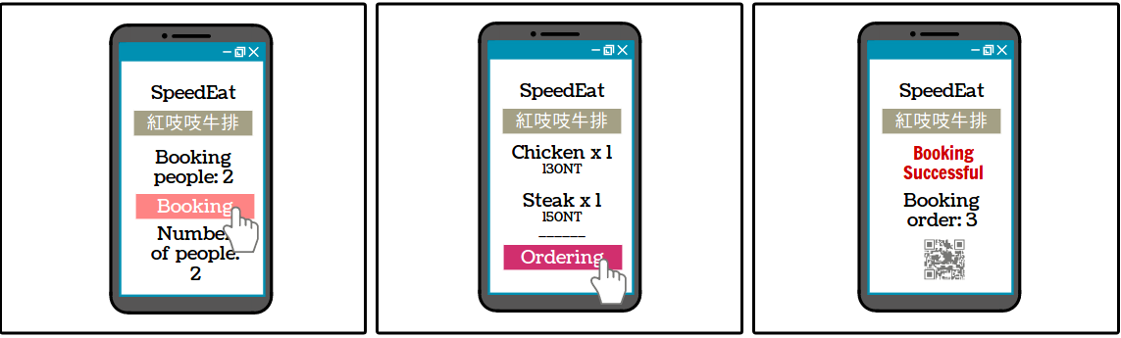
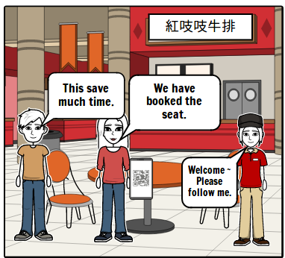
Storyboard and Storytelling - Scenarios 1
After using our system…
Situation
System

Slide 19
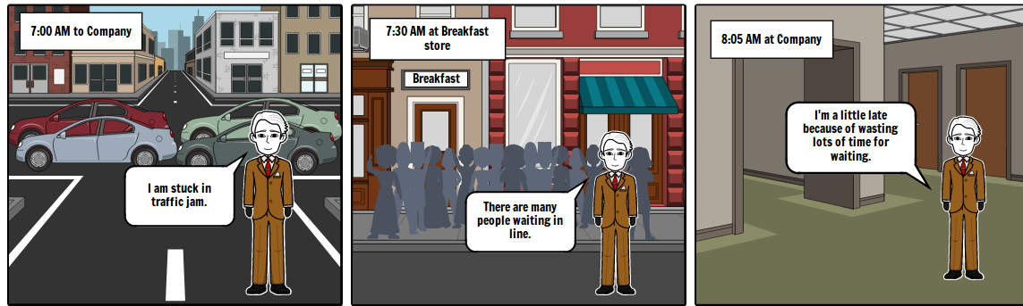
Storyboard and Storytelling - Scenarios 2
Before using our system…

Slide 20
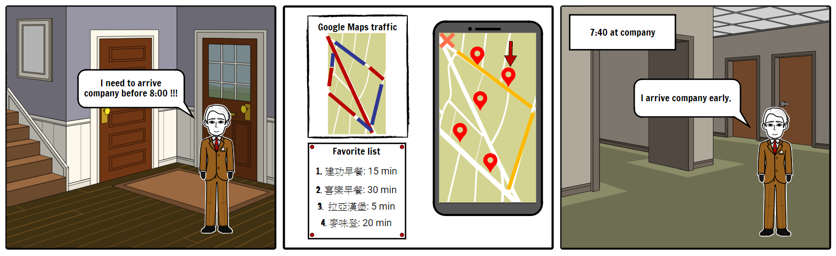
Storyboard and Storytelling - Scenarios 2
After using our system…
Situation
System

Slide 21
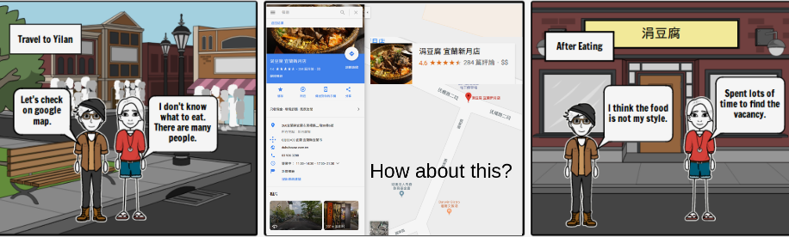
Storyboard and Storytelling - Scenarios 3
Before using our system…

Slide 22

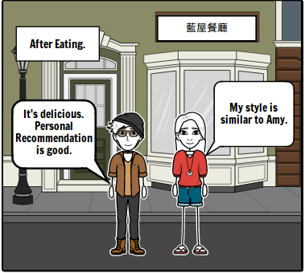
Storyboard and Storytelling - Scenarios 3
After using our system…
Situation
System

Slide 23
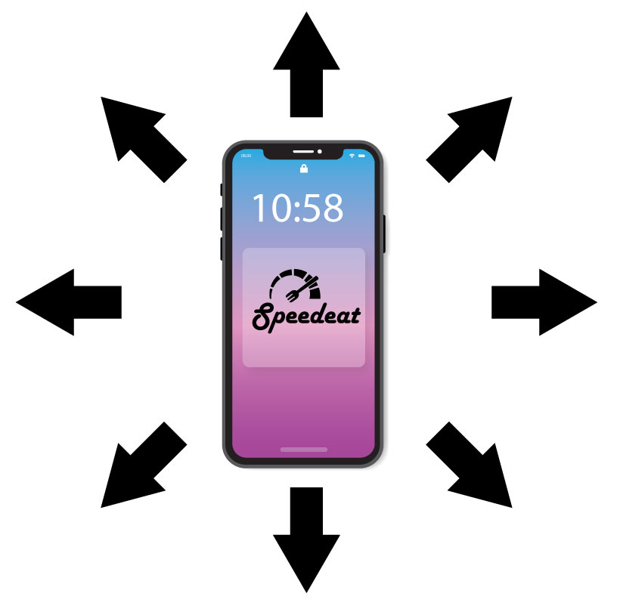
Implementation Prototype
Basing on the Interviews and Affinity diagram results, we decided that, to satisfy all the users needs, we need to expand our original idea. The expansion should be done very carefully, so our application remains consistent and coherent.

Slide 24
Implementation Prototype
To achieve this, we created a map of application functions, what helped us establish our idea and identify the key paths.

Slide 25
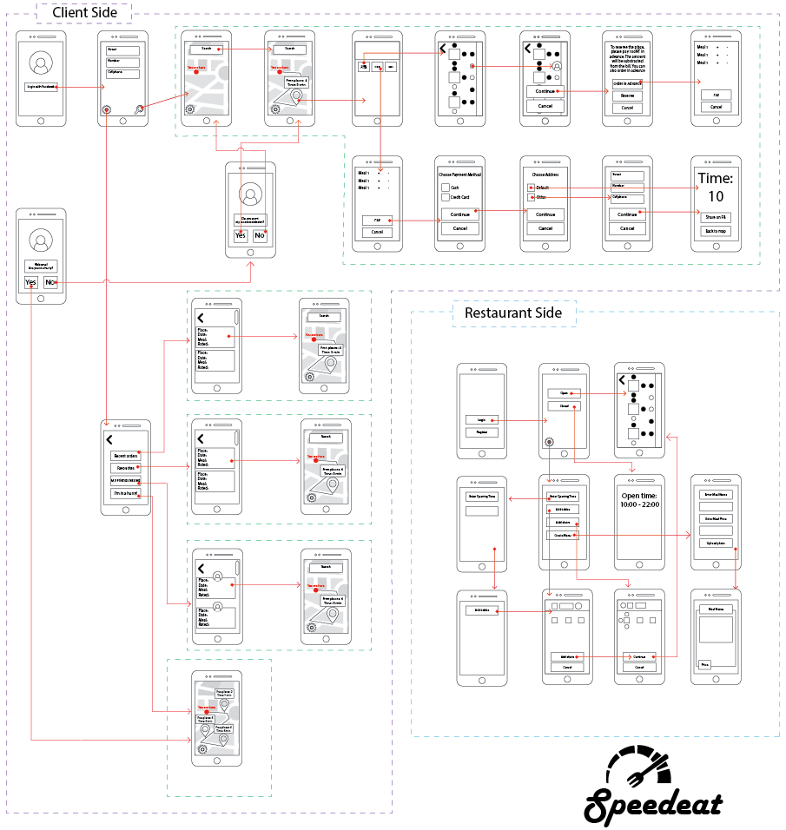

Slide 26
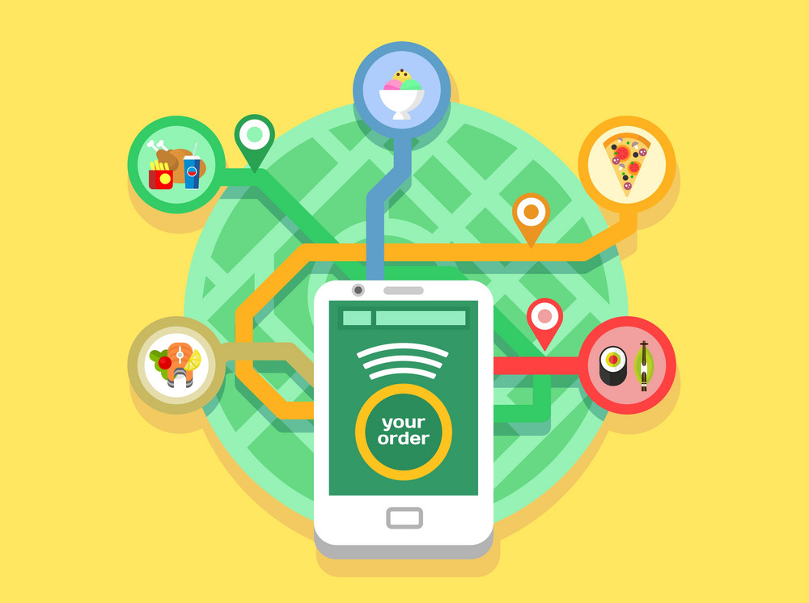
Implementation Prototype
We started with adding possibility of ordering and shipping to users home.

Slide 27
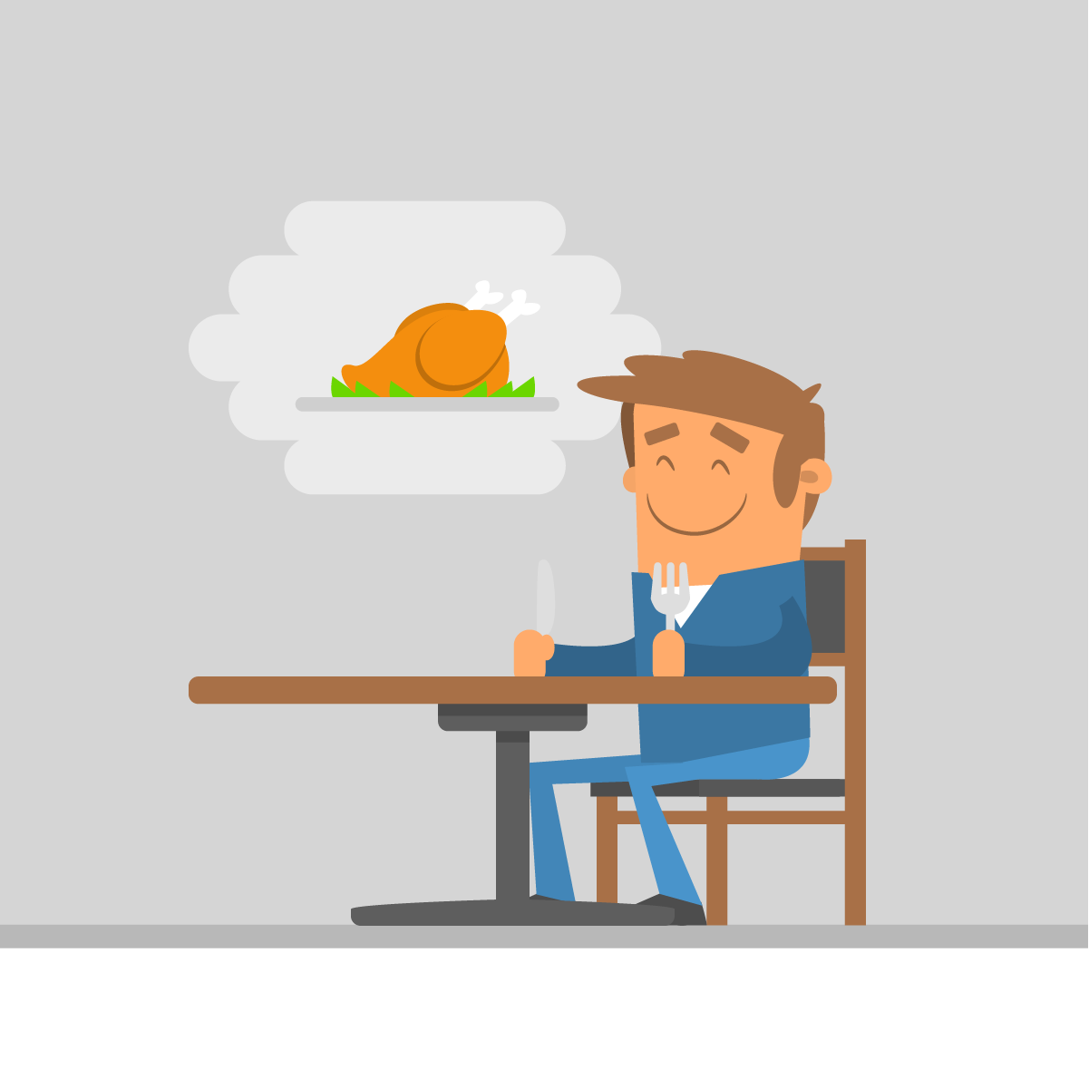
Implementation Prototype
Then we added option to pre order food, so it will wait for the user when he will arrive to the restaurant.

Slide 28
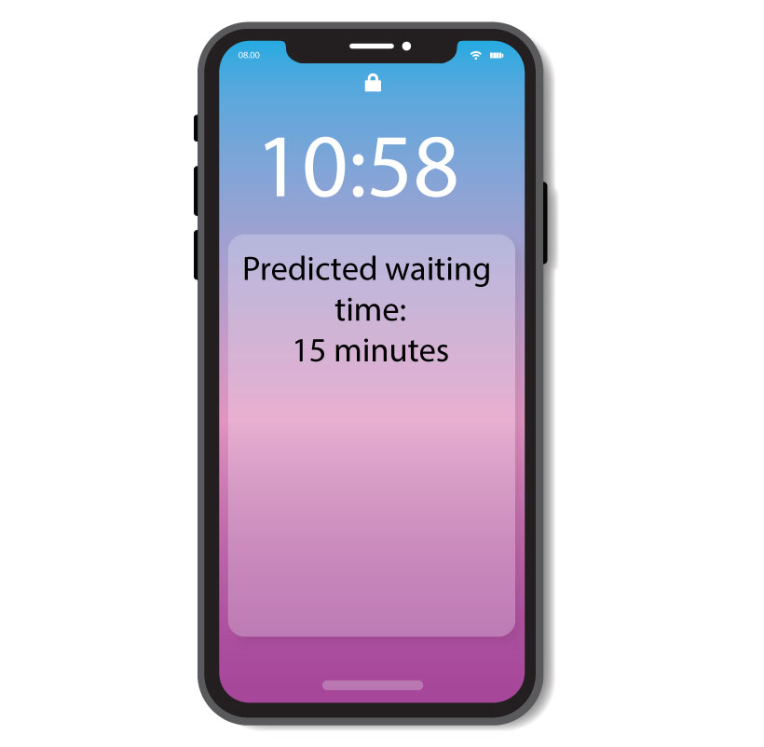
Implementation Prototype
In the original idea we are already connected with Google Traffic, what should help us predict the time the user needs to get to the certain restaurant. We decided to use it to also show the user the time the deliverer needs to bring the food to his home.

Slide 29
Implementation Prototype
Key functions after Interview, Affinity diagram and second “brainstorming”:
Client Side:
  Finding the restaurant by type of the food/name
  Showing free chairs and the time the user needs to get to the restaurant
  “I’m in a hurry” feature that will show closest restaurants with free seats
  Preview opening hours
  Reserve seat
  Reserve seat and preorder food
  Order food to home with previewing the time for it to arrive
  Order the food to the default address/adding new address
  Order food and pay using credit card/paying on arrival by cash

Slide 30
Implementation Prototype
Key functions after Interview, Affinity diagram and second “brainstorming”:
Client Side:
  Automatically created list of previous meals
  Creating the list of favorite restaurants
  Sharing best meals on Facebook
  Seeing what meals friends shared

Slide 31
Implementation Prototype
Key functions after Interview, Affinity diagram and second “brainstorming”:
Restaurant Side:
  Displaying opening time
  Adding tables and seats
  Marking seats as taken/free with only one click/touch
  Changing the arrangement of the seats/tables at any time
  Creating/updating online menu with photos

Slide 32
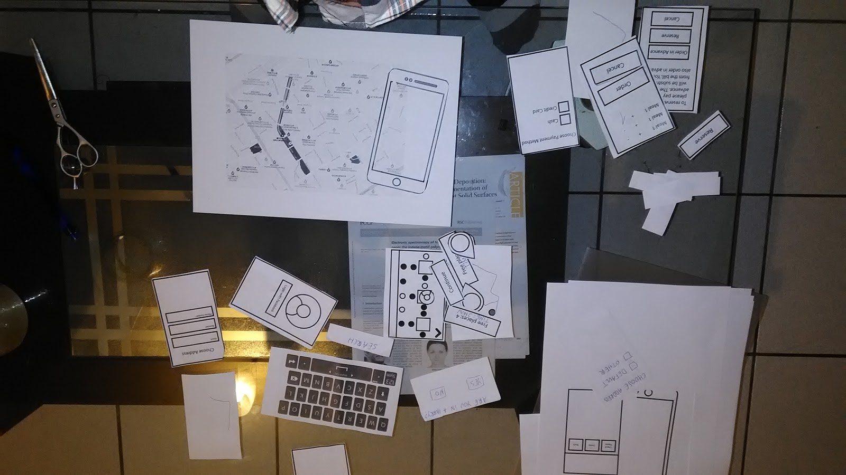
User Testing - preparation
Paper Prototype

Slide 33
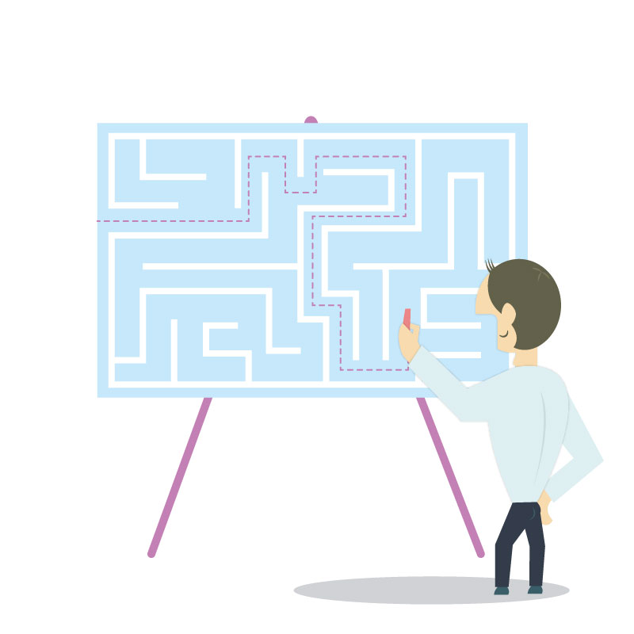
User Testing - Knowledge gained after user testing
Our app design makes it easy to navigate and understand for the user
It was easy for us to recreate key paths for the user to navigate through
We should add the possibility of adding default credit card, so the user doesn’t have to fill the field every time
We should add the option to pay with default card/entering different credit card number

Slide 34
Video links
https://drive.google.com/file/d/1kDrkPIFpcc4-u7MkpfZZasgysey9LizN/view?usp=sharing
https://drive.google.com/file/d/1X_mjErffDd12garXR0MrfEHIDsVZlW3P/view?usp=sharing
https://drive.google.com/file/d/1tNyCusNwDYHS0_UOVY7ZveRPIxR0QdLt/view?usp=sharing
https://drive.google.com/file/d/19e7AmIdDuQvNQ-N5gqfS-0FCO0vk7C-O/view?usp=sharing

Slide 35
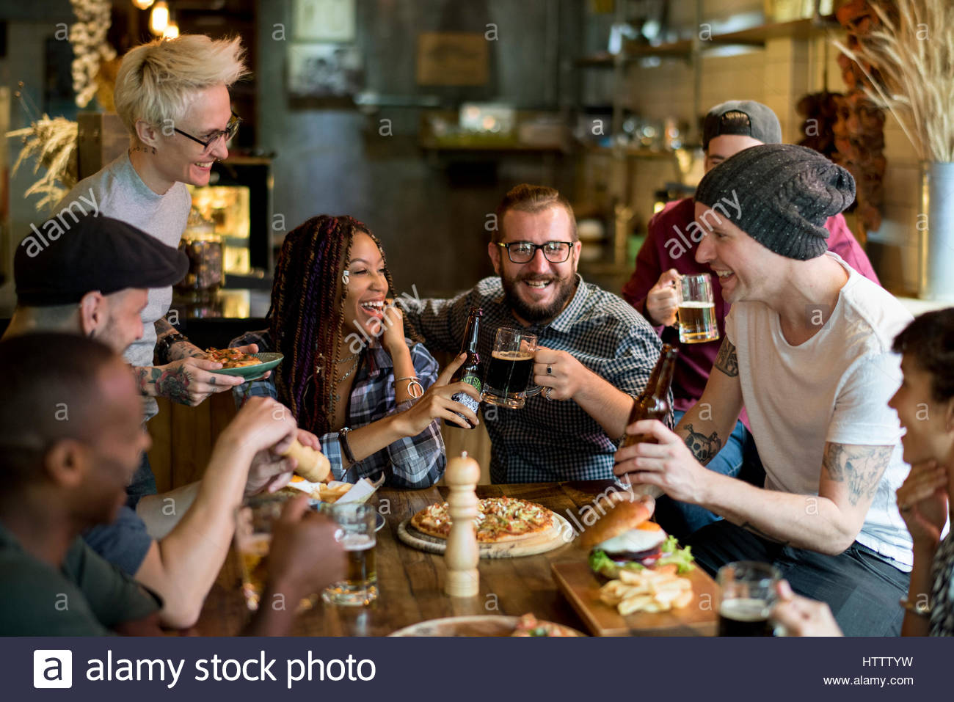

Thanks for your listening

